Slide 2
Identity, Entitlement and Access Management
Syed Aquib
Security Fundamentals For Cloud

Slide 3
CC ZG504, Cloud Security Foundations Lecture No.3

Slide 4
Agenda
Part 1: Federated Identities (45 minutes)
Understanding Federated Identities
Types of Federation
Federation Protocols and Technologies
Use Cases for Federated Identities
Part 2: IAM Protocols and Specifications (45 minutes)
IAM Protocols and Specifications
SAML (Security Assertion Markup Language)
OAuth and OpenID Connect
Part 3: Entitlement Management and IAM Audit (30 minutes)
Entitlement Management
IAM Audit
IAM Trends and Future Directions
Q&A and Group Activity (30 minutes)

Slide 5
Session 2: A Quick Recap IAM Fundamentals and Cloud Challenges
IAM Defined:
Manages digital identities and their access to resources
Key components: Identification, Authentication, Authorization
Crucial for cloud security: Protects data, ensures compliance, enables collaboration
Cloud IAM Challenges:
Complexity: Multiple clouds, diverse users, many devices
Dynamic environments: Rapid changes in infrastructure and access needs
Security threats: Account takeover, unauthorized access, privilege escalation

Slide 6
Session 2: A Quick Recap
IAM Best Practices
Key IAM Best Practices:
Strong passwords & MFA
Least privilege access
Regular access reviews
Centralized IAM solutions
Automated user provisioning/deprovisioning

Slide 7
Understanding Federated Identities
Definition:
A federated identity system establishes a trust relationship between multiple service providers (also called relying parties) and a central identity provider (IdP). This allows users to authenticate themselves once with the IdP and gain access to all connected services without needing to re-enter their credentials.
Think of it as a digital passport. You present your passport once at the airport, and it grants you access to various services within the airport, like boarding your flight, accessing lounges, or even making duty-free purchases. Similarly, a federated identity grants access to a suite of digital services after a single authentication.

Slide 8
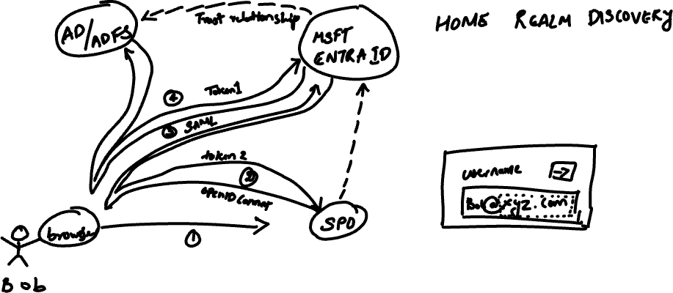
Authentication fundamentals: Federation

Slide 9
Federated Identities Key Benefits
Simplified User Experience:
Single Sign-On (SSO): Users only need to remember one set of credentials for the IdP, eliminating the need to juggle multiple logins.
Seamless Access: Once authenticated, users can move between connected services without any additional login prompts, enhancing productivity and convenience.
Reduced Administrative Overhead:
Centralized Management: User identities and access privileges are managed centrally by the IdP, simplifying account provisioning, de-provisioning, and password resets.
Streamlined Onboarding: New users can be quickly granted access to necessary services, reducing the administrative burden on IT teams.
Improved Security:
Strong Authentication: IdPs often implement robust authentication mechanisms like multi-factor authentication (MFA), adding an extra layer of security compared to individual service providers.
Reduced Password Fatigue: With fewer passwords to remember, users are less likely to resort to weak or reused passwords, mitigating the risk of credential breaches.
Centralized Access Control: The IdP acts as a gatekeeper, ensuring that only authorized users can access specific services, reducing the risk of unauthorized access.

Slide 10
Types of Federation
1. Web-Based Federation
This type of federation, also known as social login or identity federation for consumer-facing applications, allows users to leverage their existing accounts from popular social media platforms (like Google, Facebook, or Twitter) or other web-based identity providers to log in to third-party websites or applications.
How it Works:
The user initiates the login process on the third-party website or application.
They are redirected to the chosen identity provider's login page.
After successful authentication with the identity provider, the user is granted access to the third-party service.
Benefits:
Streamlined User Onboarding: Eliminates the need for users to create new accounts, reducing friction and increasing conversion rates.
Enhanced User Experience: Offers a familiar and convenient login experience, leveraging the trust users have in their existing accounts.
Reduced Password Fatigue: Minimizes the number of passwords users need to remember, contributing to better security practices.

Slide 11
Types of Federation
2. Enterprise Federation
This type of federation focuses on enabling seamless access to resources and applications across different departments, business units, or even partner organizations within an enterprise ecosystem.
How it Works:
A central identity provider (IdP) manages user identities and access privileges within the enterprise.
Various internal applications and services are configured to trust the IdP.
Employees can use their enterprise credentials to access authorized resources across the organization.
Benefits:
Centralized Identity Management: Simplifies user provisioning, de-provisioning, and access control across the enterprise.
Improved Productivity: Employees can seamlessly access the resources they need without multiple logins, enhancing efficiency.
Enhanced Security: Centralized access control and strong authentication mechanisms help protect sensitive enterprise data.

Slide 12
Types of Federation
3. Cross-Domain Federation
This advanced form of federation extends identity management and access control across different security domains or even separate organizations. It enables secure collaboration and resource sharing while maintaining control over sensitive data.
How it Works:
Multiple organizations establish trust relationships and agree on common identity standards and protocols.
Users from one organization can access resources in another organization's domain after authenticating with their own IdP.
Access control policies ensure that users only have access to authorized resources in the partner organization's domain.
Benefits:
Secure Collaboration: Facilitates seamless and secure collaboration between organizations, enabling efficient information sharing and joint projects.
Streamlined Business Processes: Simplifies cross-organizational workflows, such as supply chain management or partner portals.
Enhanced Security: Maintains control over sensitive data by enforcing access policies even when sharing resources across domains.

Slide 13
Federation Protocols and Technologies
1. Security Assertion Markup Language (SAML)
What it is: An XML-based standard that defines a framework for exchanging authentication and authorization information between an IdP and an SP.
How it Works:
The user attempts to access a protected resource on the SP.
The SP redirects the user to the IdP for authentication.
The IdP authenticates the user and generates a SAML assertion containing information about the user's identity and attributes.
The IdP sends the SAML assertion back to the SP.
The SP validates the assertion and grants the user access to the requested resource based on the information in the assertion.
Links:
https://www.microsoft.com/en-in/security/business/security-101/what-is-security-assertion-markup-language-saml

Slide 14
Federation Protocols and Technologies
2. OAuth
What it is: An open standard for authorization that allows users to grant third-party applications limited access to their protected resources without sharing their credentials.
How it Works:
The user initiates an action on a third-party application that requires access to their protected resources on another service.
The application redirects the user to the resource owner's authorization server.
The user authenticates and grants the application access to specific resources.
The authorization server issues an access token to the application.
The application uses the access token to access the authorized resources on behalf of the user.
Links:
https://developers.google.com/identity/protocols/oauth2
https://oauth.net/2/

Slide 15
Federation Protocols and Technologies
3. OpenID Connect
What it is: An identity layer built on top of the OAuth 2.0 protocol, providing a simple and secure way to verify user identity and obtain basic profile information.
How it Works:
Leverages OAuth's authorization framework to authenticate users and obtain an ID token.
The ID token contains claims about the user's identity, such as their name, email address, and other profile information.
The application can use the ID token to verify the user's identity and personalize the user experience.
Links:
https://developers.google.com/identity/openid-connect/openid-connect
https://developers.google.com/identity/gsi/web/guides/overview

Slide 16
Feature | SAML | OAuth | OpenID Connect
Primary Purpose | Authentication & Authorization | Authorization | Authentication & Basic Profile Information
Data Exchange Format | XML | JSON | JSON (JWT)
Typical Use Cases | Enterprise SSO, Federated access to web services | Social media integrations, Cloud storage access, Third-party payment processing | User registration & login, Personalization, SSO
Strengths | Strong security, Fine-grained access control, Widely used in enterprise environments | Delegated authorization, Wide adoption for third-party integrations | Simple integration, Built on OAuth, Provides basic user information
Limitations | Complex implementation, Less suitable for mobile or consumer-facing applications | Primarily focused on authorization, Not designed for user authentication | Relies on OAuth for underlying authorization

Slide 17
Use Cases for Federated Identities
1. Single Sign-On (SSO)
Scenario: Employees in an organization need to access multiple internal applications and cloud-based services daily.
How Federated Identities Help:
Centralized Authentication: A single set of credentials (often tied to the corporate directory) is used to access all connected applications.
Seamless Access: Users authenticate once and can then navigate between different applications without additional login prompts.
Reduced Password Fatigue: Employees only need to remember one strong password, minimizing the risk of weak or reused passwords.
Improved Productivity: Eliminates the time and frustration associated with multiple logins, boosting efficiency.
Example: An employee logs in to the company intranet and can then seamlessly access their email, project management tools, HR portal, and cloud-based CRM system without needing to enter their credentials again.

Slide 18
Use Cases for Federated Identities
2. Business-to-Business (B2B) Collaboration
Scenario: Companies need to securely share resources and data with partners, suppliers, or customers.
How Federated Identities Help:
Secure Access Control: Partners and suppliers can access authorized resources using their own identity provider (IdP), eliminating the need to create and manage separate accounts.
Streamlined Onboarding: New partners can be quickly granted access to necessary resources, accelerating collaboration.
Reduced Administrative Overhead: Identity and access management is simplified, as each organization manages its own users.
Enhanced Security: Centralized access control and strong authentication mechanisms protect sensitive data shared between organizations.
Example: A manufacturer grants its suppliers access to a shared portal where they can view inventory levels, place orders, and track shipments, all using their own company credentials.

Slide 19
Use Cases for Federated Identities
3. Customer Identity and Access Management (CIAM)
Scenario: Businesses need to manage customer identities and provide secure access to online services, such as e-commerce platforms, loyalty programs, or support portals.
How Federated Identities Help:
Frictionless User Experience: Customers can use their existing social media accounts or other familiar identity providers to log in, reducing barriers to entry.
Enhanced Security: Strong authentication mechanisms and centralized access control protect customer data and prevent unauthorized access.
Personalized Experiences: Businesses can gather valuable customer insights and tailor their offerings based on user identities and preferences.
Increased Engagement: Simplified login processes and personalized experiences can lead to higher customer engagement and loyalty.
Example: An online retailer allows customers to log in using their Google or Facebook accounts, simplifying the registration process and providing a more convenient shopping experience.

Slide 20
Entitlement Management
Definition:
Entitlement management is the systematic process of granting, modifying, and revoking user access privileges to resources such as applications, data, systems, or networks. It leverages a combination of roles, attributes, policies, and other criteria to determine who can access what.
Key Benefits
Ensures Users Have the Appropriate Level of Access:
Principle of Least Privilege: Entitlement management enforces the principle of least privilege, granting users only the minimum necessary access to perform their tasks. This minimizes the potential damage in case of accidental or malicious actions.
Role-Based Access Control (RBAC): Users are assigned roles that define their access rights, simplifying the management of permissions as users move between roles or departments.
Attribute-Based Access Control (ABAC): Access decisions can be made based on user attributes like department, location, or clearance level, enabling more fine-grained and dynamic access control.
Reduces the Risk of Unauthorized Access and Data Breaches:
Centralized Access Control: Entitlement management provides a centralized view of user access rights, making it easier to identify and address potential security risks.
Automated Provisioning and De-provisioning: User access can be automatically granted or revoked based on predefined rules, minimizing the risk of human error and ensuring timely access changes.
Auditing and Compliance: Entitlement management systems maintain detailed logs of access requests and changes, aiding in audits and ensuring compliance with regulatory requirements.
Simplifies Access Management in Complex Environments:
Scalability: Entitlement management solutions can handle large numbers of users and resources, making them suitable for complex enterprise environments.
Integration with Identity Management Systems: Entitlement management often integrates with identity management systems, providing a unified view of user identities and access rights.
Workflow Automation: Automating access request and approval workflows streamlines the process and reduces administrative overhead.

Slide 21
IAM Audit
User Access Reviews:
Purpose: Regularly assess whether users have the appropriate access privileges based on their roles and responsibilities.
Process: Review access rights for all users, especially those with elevated privileges or access to sensitive data. Identify and revoke any unnecessary or excessive access.
Tools: Utilize IAM solutions with built-in access review capabilities or leverage third-party audit tools.
Privilege Escalation Checks:
Purpose: Identify potential pathways for users to gain unauthorized access to sensitive resources or elevate their privileges.
Process: Examine configurations, access control lists, and user activity logs to detect any misconfigurations or suspicious patterns that could lead to privilege escalation.
Tools: Employ vulnerability scanners, penetration testing tools, and security information and event management (SIEM) systems to monitor and analyze user behavior.

Slide 22
IAM Audit
Log Analysis:
Purpose: Review system and application logs to detect any unauthorized access attempts, suspicious activities, or policy violations.
Process: Collect and analyze logs from various IAM components (like authentication servers, directory services, and access management tools) to gain insights into user behavior and identify potential threats.
Tools: Utilize log management and analysis tools, SIEM systems, and user behavior analytics (UBA) solutions to detect anomalies and patterns.
Compliance Audits:
Purpose: Ensure that your IAM practices comply with relevant industry standards, regulations, and internal policies.
Process: Conduct comprehensive audits to assess your IAM policies, procedures, and controls against regulatory requirements and internal benchmarks. Identify and remediate any gaps or non-compliance issues.
Tools: Leverage compliance audit frameworks, checklists, and specialized audit software to streamline the process and ensure thoroughness.

Slide 23
IAM Audit
Identifying Vulnerabilities: Regular audits help uncover weaknesses or gaps in your IAM system, allowing you to proactively address potential security risks before they are exploited.
Ensuring Compliance: Audits help you demonstrate adherence to regulatory requirements (like GDPR, HIPAA, or PCI DSS) and internal policies, avoiding penalties and reputational damage.
Optimizing Access Controls: Audits enable you to assess the effectiveness of your access controls, ensuring that users have the right level of access to perform their duties without compromising security.
Improving Operational Efficiency: Audits can reveal areas for improvement in your IAM processes, leading to streamlined workflows and reduced administrative overhead.
Building Stakeholder Trust: Demonstrating a commitment to regular IAM audits fosters trust among customers, partners, and employees, showcasing your dedication to data security and privacy.

Slide 24
Identity Federation
Identity federation is a trust relationship established between multiple organizations or domains, allowing them to share identity information and authentication mechanisms. It enables users from one domain (the identity provider) to access resources in another domain (the service provider) without the need to create and manage separate accounts for each service.
Benefits of Identity Federation
Identity federation offers several advantages for both users and organizations:
Improved User Experience: Users no longer need to remember multiple usernames and passwords for different services. They can log in once with their primary credentials and seamlessly access multiple services.
Reduced Administrative Overhead: Organizations can streamline user management by centralizing identity information and authentication processes. This reduces the administrative burden of managing multiple user accounts and passwords.
Enhanced Security: Identity federation can improve security by implementing strong authentication mechanisms and access controls at the identity provider level. This helps prevent unauthorized access to sensitive data and resources.
Increased Collaboration: Identity federation facilitates collaboration between organizations by enabling secure and seamless access to shared resources.

Slide 25
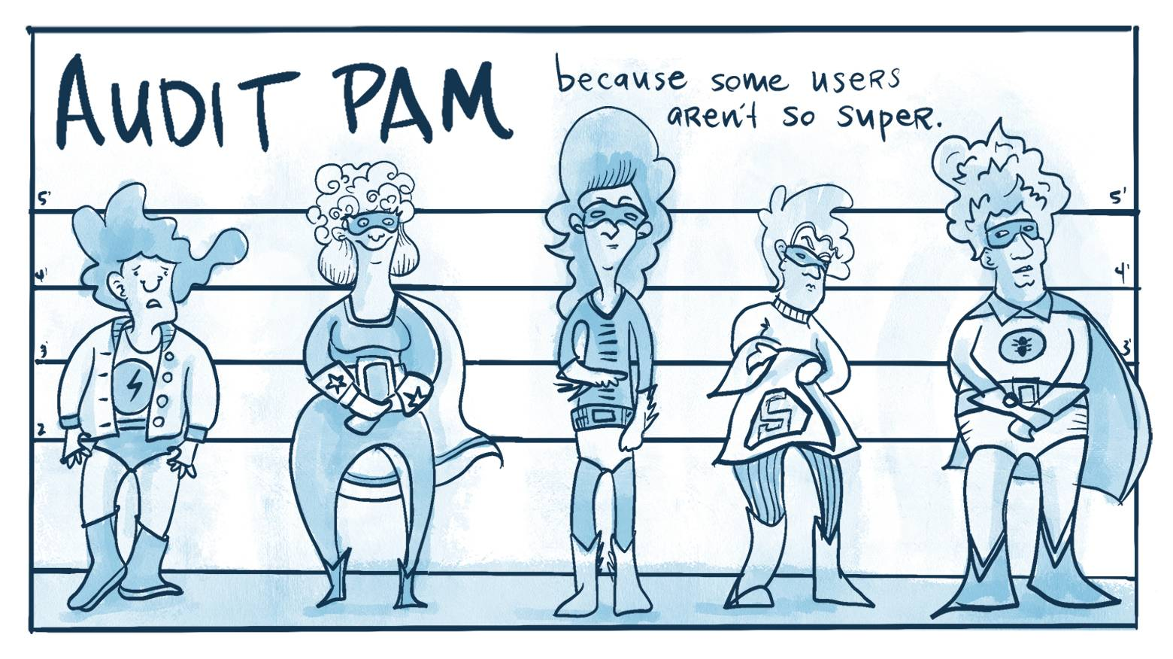
Privileged Access Management (PAM)

Slide 26
Privileged Access Management (PAM)
PAM encompasses the strategies, technologies, and processes designed to manage and secure accounts with elevated privileges. It aims to control, monitor, and audit the access and activities of privileged users, ensuring that they are using their privileges responsibly and preventing any unauthorized or malicious use.
Importance of PAM
The importance of PAM cannot be overstated, given the potential consequences of privileged account compromise:
Protection against Insider Threats: PAM helps mitigate the risks posed by malicious insiders or negligent employees who may misuse their privileges, intentionally or unintentionally.
Defense against Privilege Escalation Attacks: Cybercriminals often target standard user accounts to gain initial access, and then attempt to escalate their privileges to gain control over privileged accounts. PAM helps thwart such attacks by implementing stringent access controls and monitoring privileged activities.
Compliance with Regulatory Requirements: Many industry regulations and data privacy standards mandate the protection of privileged accounts. PAM helps organizations demonstrate compliance by implementing robust controls and audit trails.

Slide 27
Privileged Access Management (PAM)
Key Features of PAM Solutions
Modern PAM solutions offer a range of features to enhance the security of privileged accounts:
Just-in-Time Access: Instead of granting permanent privileges, PAM solutions can provide temporary, time-limited access to privileged accounts, reducing the window of opportunity for attackers.
Session Monitoring and Recording: PAM solutions can monitor and record privileged user sessions, providing valuable insights into their activities and enabling the detection of suspicious behavior.
Password Vaulting: PAM solutions can securely store and manage privileged credentials, eliminating the need for users to remember or share passwords, thereby reducing the risk of credential theft.
Multi-Factor Authentication (MFA): PAM solutions often require privileged users to provide multiple factors of authentication to access privileged accounts, adding an extra layer of security.
Least Privilege Enforcement: PAM solutions can enforce the principle of least privilege, ensuring that privileged users have only the minimum necessary permissions to perform their tasks.

Slide 28

Gartner Hype Cycle

Slide 29
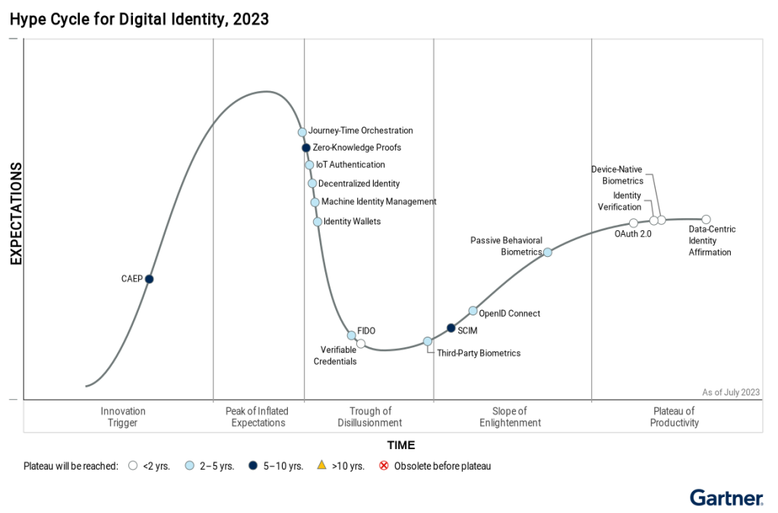
Hype Cycle for Identity

Slide 30
IAM Trends and Future Directions
Artificial Intelligence (AI) and Machine Learning (ML)
Anomaly Detection: AI and ML algorithms can analyze vast amounts of user behavior data to identify patterns and detect anomalies that may indicate potential security threats or unauthorized access attempts. This enables proactive threat detection and response, allowing organizations to take preventive measures before a breach occurs.
Risk-Based Authentication: AI and ML can assess the risk associated with each access request based on various factors, such as user behavior, device information, and location. This allows for dynamic authentication policies, where additional verification steps are triggered only when the risk level is high, striking a balance between security and user convenience.
Predictive Threat Modeling: By analyzing historical data and identifying patterns, AI and ML can predict potential threats and vulnerabilities, helping organizations proactively strengthen their IAM defenses and prevent future attacks.

Slide 31
IAM Trends and Future Directions
Zero Trust
"Never Trust, Always Verify" Approach: The Zero Trust model assumes that no user or device should be trusted implicitly, even if they are within the corporate network. Instead, every access request is verified and authenticated, regardless of the user's location or device.
Continuous Authentication and Authorization: Zero Trust advocates for continuous monitoring and verification of user identities and access rights throughout the session, ensuring that access is granted only when needed and revoked when no longer required.
Microsegmentation: Zero Trust promotes the concept of microsegmentation, where the network is divided into smaller, isolated segments, limiting the lateral movement of attackers in case of a breach.

Slide 32
IAM Trends and Future Directions
Decentralized Identity
User-Controlled Identity: Decentralized identity models aim to give users more control over their digital identities, allowing them to manage and share their personal information selectively with different service providers. This reduces the reliance on centralized identity providers and empowers users to protect their privacy.
Self-Sovereign Identity (SSI): SSI is a type of decentralized identity model where users store their identity data in secure digital wallets and present verifiable credentials to service providers as needed. This enables users to control their personal data and share it on their terms.
Blockchain-Based Identity: Blockchain technology offers a secure and tamper-proof way to store and manage identity data. It can enable decentralized identity systems where identity verification and authentication are performed on the blockchain, enhancing trust and transparency.

